Slide 1
Recommended Journals for Publication Based on Paper Abstract.

Slide 2
Overview
Finding the right journal to publish your paper in is not always a trivial task. While usually authors write their paper with a target journal in mind in case of rejection there are not always obvious alternatives. Moreover, the target journal may just be a biased decision based on the author previous experience and does not guarantee that the article will get the best exposure. In this project I propose to build a recommender system which can identify the best journal candidates for publication based on paper abstract similarity. The underlying assumption of this system is that journals who publish high volume of articles which are similar to the proposed paper will give the best exposure and acceptance chances.

Slide 3
Dataset
The data will be downloaded from the Semantic Scholar Open Research Corpus which contains over 39 million records of published articles. The records contain journal name, author name and abstract among other fields.
The data is distributed as 30 json files. The data itself is not clean and contain many entries with missing values and gibberish text as needs some cleaning. As our main interest is in the journal and abstract fields, entries with missing/corrupt data in those fields were deleted.

Slide 4
EDA
The plot shows the distribution of papers as a function of language
English is by far the most popular language (98.7% of the total publications)
In the final analysis only the abstracts that were identified as English will be taken into account.

Slide 5
EDA
Total number of publications as a function of year
Seems like there is a huge jump in the late 70's when personal computers entered the market. Another jump when the internet became popular, and it seems to be growing exponentially

Slide 6
Recommender system
We use vector embeddings to calculate the distance between the supplied abstract and the abstracts in the database. The top 500 abstracts are chosen for analysis
For each paper we calculate a combined score based on similarity, number of citation and the year punished (sometimes there's a surge of interest in a topic for a time period and then it subdues for certain journals)
The results are aggregated by journal and a mean score is used to rank journals for recommendation

Slide 7
Performance metric – checking if random abstracts selected from google scholar will recommend the original publication. Also checked a few of my own publications Best results were obtained from doc2vec
Different Methods For Calculating Document Embedding
Document is represented as mean of word vectors
TF/IDF
word2vec
glove
The embedding is computed for the complete document
Doc2vec
LDA

Slide 8
Paragraph Distance
Scatter plot of the three most most important components of the PCA for five randomly selected publications from three different journals:
Physical review letters(yellow)
Applied health economics and health policy(purple)
Molecular and cellular biology
Two components did not show significate clustering While we can see some clustering it is also seems that there is a scatter of topics within each publication

Slide 9
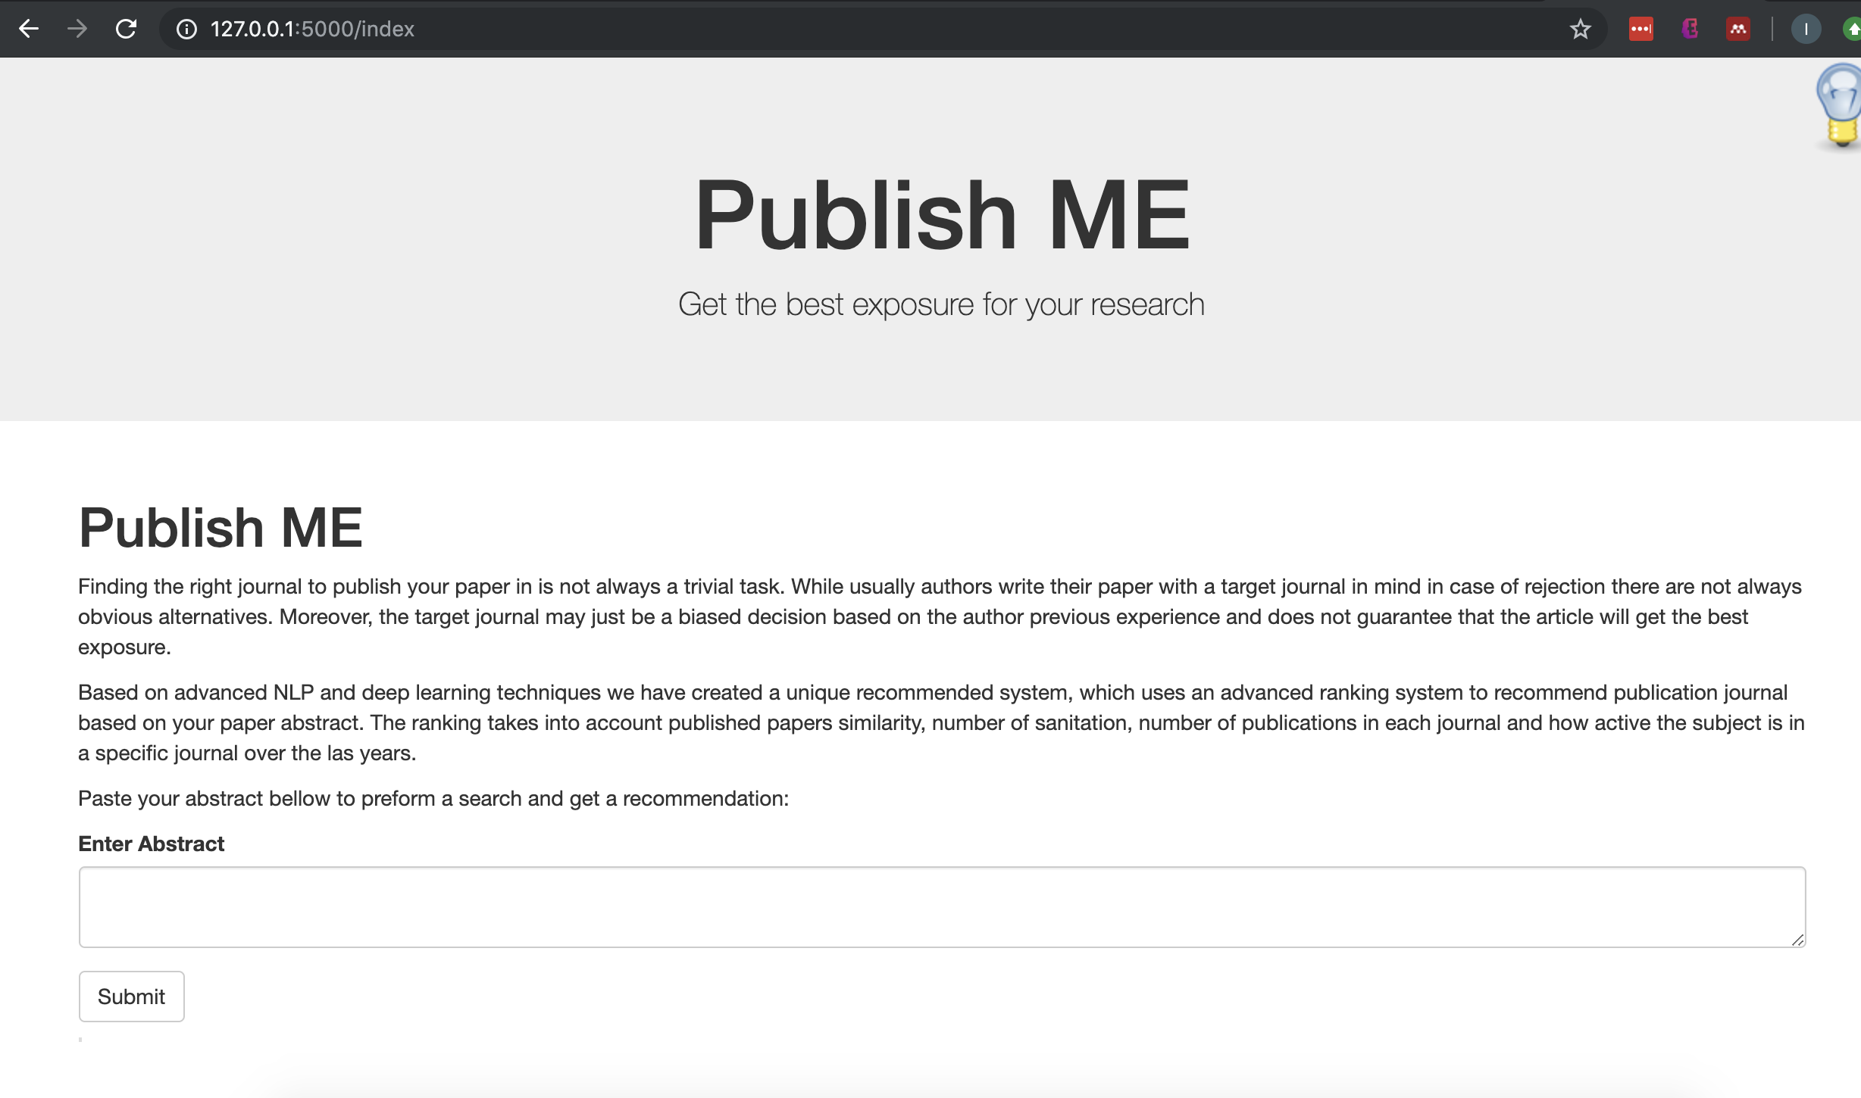
The final product Website which will recommend journals for publication based on submitted abstract

Slide 10
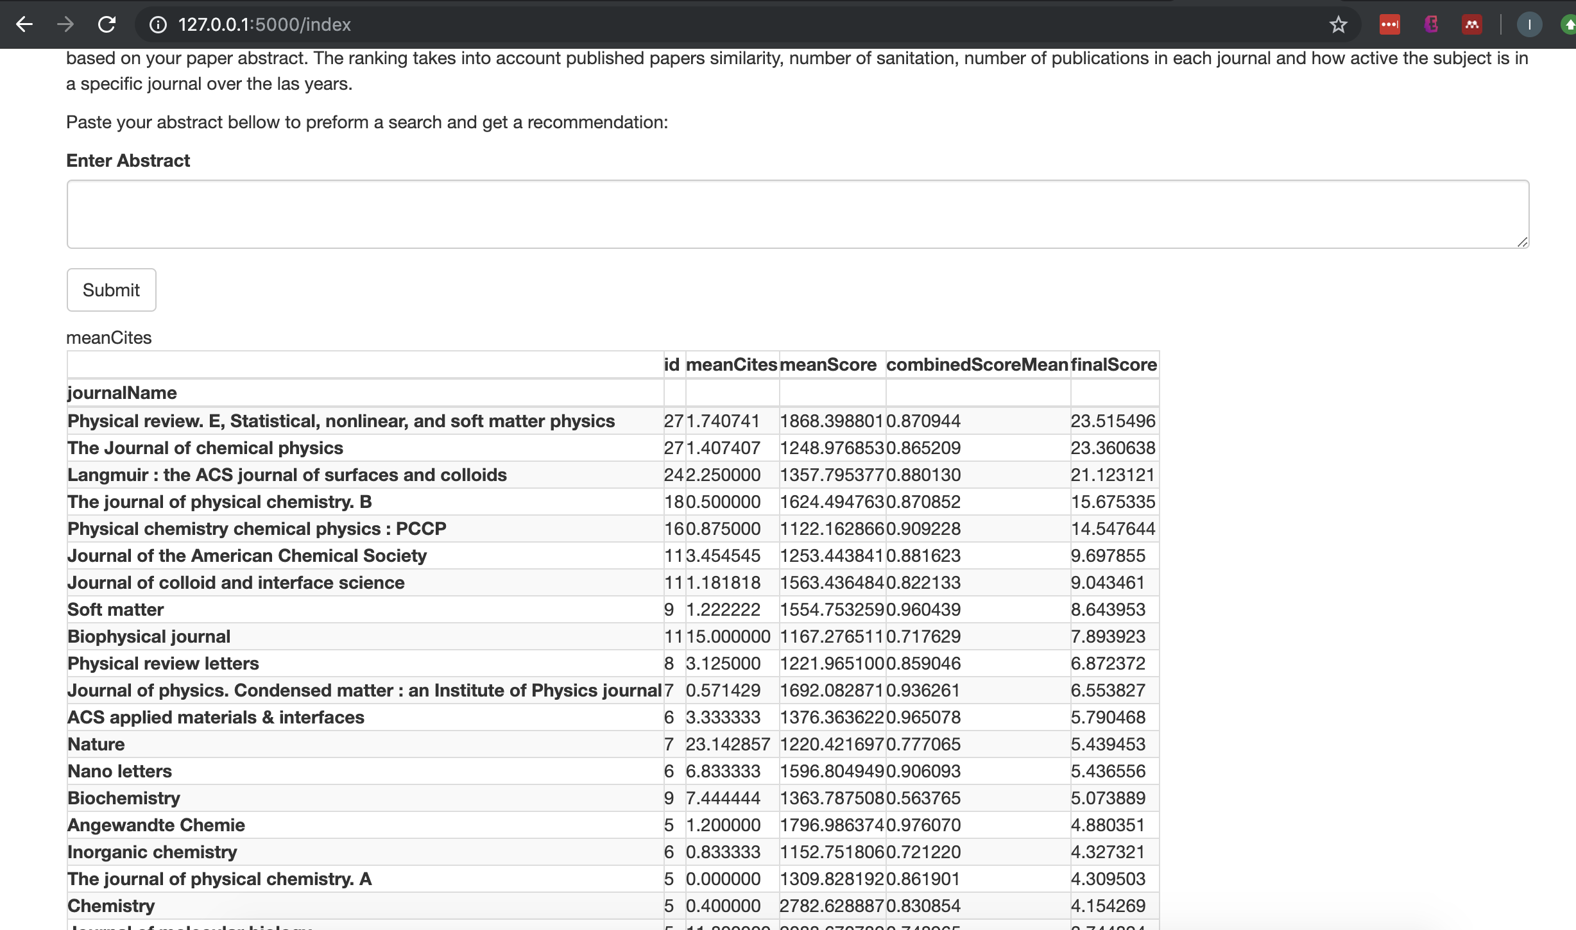
The final product Testing on one of my own papers, the results are the exact ones I would consider publishing at

Slide 11
Future work
Optimize and test LDA (initial findings and the doc2vec paper hints that it will perform worse then the current method, but can be useful for topic extraction)
Topic extraction
Recommend papers to cite
Find similar work and cross reference with current citations
Build authors graph for papers similar to the abstract submitted to find main influencer in the field

